Slide 1
Families first coronavirus response act guidance
Human resources
April 14, 2020

Slide 2
Agenda
Families First Coronavirus Response
Emergency Paid Sick Leave
Emergency Family and Medical Leave Expansion
Resources

Slide 3
Families First Coronavirus Response
Effective April 1, 2020, the Families First Coronavirus Response Act (FFCRA) provides employees with two additional types of leave.
Employees with a qualifying circumstance as defined by the FFCRA will be eligible for up to 80 hours of Emergency Paid Sick Leave.
Employees who have a child whose school or place of care is closed will be eligible for leave under the Family and Medical Leave Act (FMLA), a portion of which is paid leave.
These provisions will apply from April 1, 2020 through December 31, 2020.

Slide 4
Families First Coronavirus Response
This new leave is in addition to leave employees are entitled to under the Employee and Labor Relations Manual (ELM) and any applicable Memorandum of Understanding (MOUs).
Failure to provide employees with Emergency Sick Leave or FMLA Leave for this additional qualifying reason is considered an FLSA violation, and thus can result in significant liability for the Postal Service.

Slide 5
Emergency Paid Sick Leave
Emergency Paid Sick Leave – Qualifying Reasons
An employee is entitled to take leave related to COVID-19 if the employee is unable to work, including unable to telework, because the employee: is subject to a Federal, State, or local quarantine or isolation order related to COVID-19. Please note that the Postal Service’s provision of mail and package delivery services is not affected by State and local government actions that are restricting commercial and personal activities in response to the COVID-19 pandemic. The Postal Service is an entity of the Federal Government whose employees are providing an essential government service for the American people. Our approach has been to interpret the restrictions being imposed by State and local governments as either explicitly or impliedly exempting essential federal government services from its scope. As such, it is unlikely that our employees will be considered “subject to a Federal, State, or local quarantine or isolation order related to COVID–19” for the purposes of emergency paid sick leave. Please contact HR or the Law Department if you have specific questions. has been advised by a health care provider to self-quarantine related to COVID-19. is experiencing COVID-19 symptoms and is seeking a medical diagnosis. is caring for an individual subject to an order described in (1) or self-quarantine as described in (2). is caring for a child whose school or place of care is closed (or child care provider is unavailable) due to COVID-19 related reasons. is experiencing any other substantially-similar condition specified by the U.S. Department of Health and Human Services.

Slide 6
Emergency Paid Sick Leave
Emergency Sick Leave – Hours and Pay Calculation
All career and non-career employees, regardless of tenure, are immediately eligible for up to 80 hours of fully or partially paid Emergency Sick Leave. Full time Career Employees can receive up to 80 hours of paid Emergency Sick Leave. Part-time employees must receive the number of Emergency Sick Leave hours equal to the number of hours they were scheduled to work during the 2-week period they take such leave. If an employee has a variable schedule to such an extent that the employer cannot determine how many hours of paid sick time to grant to the employee, hours shall be determined using either the average number of hours that employee was scheduled per day over the 6-month period ending on the date where the employee takes such leave, including any leave; or if the employee did not work over such a period, the reasonable expectation of the average number of hours per day the employee would be scheduled to work at the time of hiring. If an employee is scheduled to work more than 40 hours in a workweek, the employee may receive Emergency Sick Leave in that amount during the first week of taking such leave. Thus, if an employee is scheduled to work 50 hours the first week, the employee receives 50 hours of Emergency Sick Leave in the first week, and is limited to 30 hours in the second week of taking such leave. Qualifying reasons 1, 2, and 3 allow for Emergency Sick Leave at 100% of an employee’s pay, but capped at $511.00 per day and $5,110.00 in the aggregate. Qualifying reasons 4, 5, and 6 will be no less than 2/3 of an employee’s pay; but capped at $200.00 per day and $2,000.00 in the aggregate.

Slide 7
Emergency Paid Sick Leave
Required Documentation
For all qualifying reasons, the employee is required to provide: Employee’s name; Date(s) for which leave is requested; Qualifying reason for the leave (Reason Number only; no medical information); and Oral or written statement that the Employee is unable to work because of the qualified reason for leave. Additional documentation is required depending on the qualifying reason the employee identifies. Qualifying Reason 1: In the unlikely event that circumstances dictate that a Postal Service employee is eligible for EPSL for Reason 1, the employee would be required to provide, in writing or orally, the name of the government entity that issued the quarantine or isolation order. Qualifying Reason 2: The employee is required to provide, in writing or orally, the name of the health care provider who advised the Employee to self-quarantine. Depending on circumstances, this health care provider may be the District OHNA. This information should be provided to the District OHNA and kept as an employee medical record per Management Instruction EL-860-1998-2. Qualifying Reason 5: Name of the Son or Daughter being cared for; Name of the School, Place of Care, or Child Care Provider that has closed or become unavailable; AND An oral or written statement that no other suitable person will be caring for the Son or Daughter during the period for which the Employee takes Emergency Paid Sick Leave or Expanded Family and Medical Leave. Any and all documents related to a request for Emergency Paid Sick Leave must be maintained locally, for four (4) years. Supervisors must document in writing any required information provided orally by an employee.

Slide 8
Emergency Paid Sick Leave
If an employee meets one of the qualifying reasons, supervisors and managers are to grant the leave by accepting the completed PS 3971 with supporting documentation and entering the time into TACS according to timekeeping guidance.
Same return-to-work clearance applies if an employee is out due to illness. Prior to returning to work a Postal Service physician or nurse will review the employee situation and make a final determination on the return-to-work request.

Slide 9
Emergency FMLA Expansion
Emergency Family and Medical Leave Expansion
Qualifying Reasons | Leave Eligibility
An employee is entitled to take leave related to COVID-19 if the employee is unable to work, including unable to telework, because the employee: is caring for his or her child whose school or place of care is closed (or child care provider is unavailable) due to COVID-19 related reasons. Note that this qualifying reason is the same as qualifying reason number 5 for Emergency Sick Leave. | All employees that have been employed for 30 days or longer are eligible for this benefit should they meet the qualifying reason. The first two weeks (usually 10 full days) of the 12-week FMLA coverage will be unpaid. To receive paid leave, an employee can choose to use their own earned leave or may use the Emergency Sick Leave. The remaining 10 weeks of FMLA leave for this qualifying reason will be paid leave. This leave is required to be paid out at not less than 2/3 of employee’s pay, but capped at $200.00 a day and $10,000.00 in the aggregate.

Slide 10
Emergency FMLA Expansion
Required Documentation
For the qualifying reason, the employee is required to provide: Employee’s name; Date(s) for which leave is requested; Qualifying reason for the leave (care for child); Oral or written statement that the Employee is unable to work because of the qualified reason for leave. Name of the Son(s) or Daughter(s) being cared for; Name of the School, Place of Care, or Child Care Provider that has closed or become unavailable; AND An oral or written statement that no other suitable person will be caring for the Son(s) or Daughter(s) during the period for which the Emergency FMLA Expansion leave Any and all documentation related to a request for Emergency FMLA Expansion must be maintained locally for four (4) years. Supervisors must document in writing any required information provided orally by an employee.

Slide 11
Emergency FMLA Expansion
If an employee meets the qualifying reason, supervisors and managers are to grant the leave by accepting the completed PS 3971 and supporting documentation.
Once leave is entered into eRMS a FMLA case number will be created. No FMLA packet will be generated or mailed to employees. HRSSC will not manage new FMLA cases opened under this new emergency leave expansion.

Slide 12
Emergency FMLA Expansion
Employee are only entitled to 12 weeks of FMLA leave, regardless of reason.
If an employee has already exhausted their FMLA leave for this year, they are not entitled to take FMLA leave for this new qualifying reason.

Slide 13
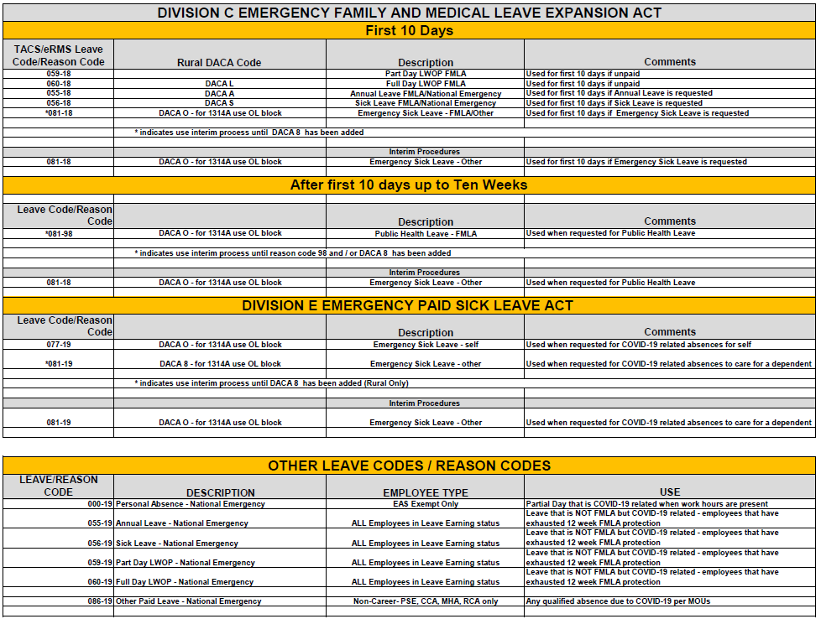
Timekeeping Reference Guide

Slide 14
Resources
Time And Attendance Guidance
TACS Webpage
https://blue.usps.gov/tacs/COVID-19%20references.htm
TACS Questions
HqTACS@USPS.Gov
eRMS Webpage
https://blue.usps.gov/erms/
eRMS Questions
KM5QJ0@usps.gov
Employee Eligibility Questions
First contact your supervisor or local HR
HR Shared Service Center @ 1-877-477-3273, Option 5
COVID-19 Blue and LiteBlue FFCRA Page
https://blue.usps.gov/blue/covid-19/families-first.htm
Frequently Asked Questions
Supervisor Quick Reference Guide
Timekeeping Quick Reference
Expanded Family and Medical Leave Supervisor Checklist
Emergency Paid Sick Leave Supervisor Checklist

